Slide 1
Startup/AngelInvesto
P Sai Saketh-097
A Krishna Chaitanya-308
B Manoj-082

Slide 2
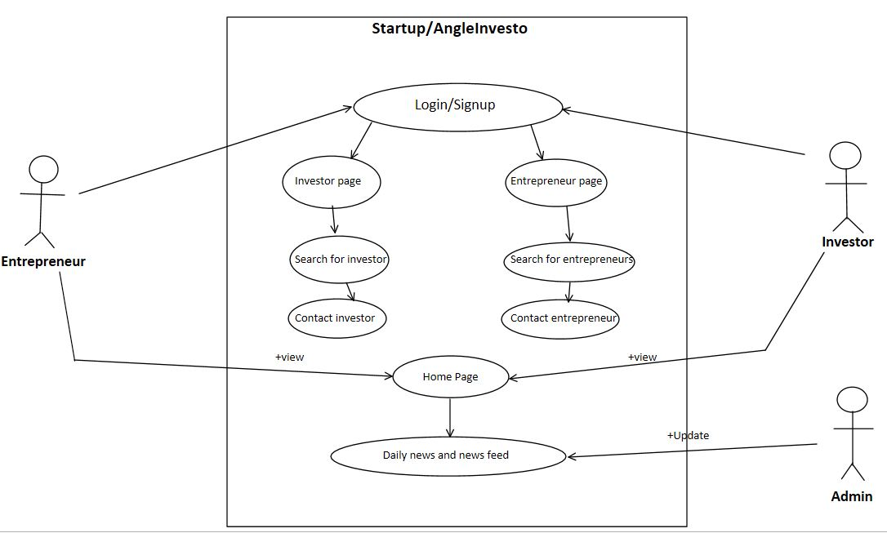

Slide 3
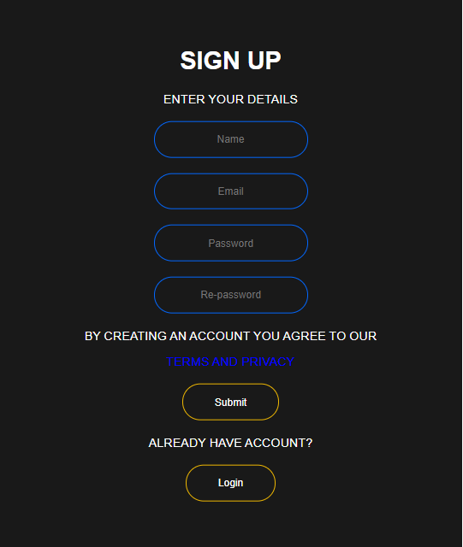
SIGNUP PAGE

Slide 4
Signup page contains
4 text fields
+ Name (users name)
+ Email (email of the user)
+ Password (password to his account)
+ Re-Password (re enter his password)
2 buttons
+ Submit
+ Login

Slide 5
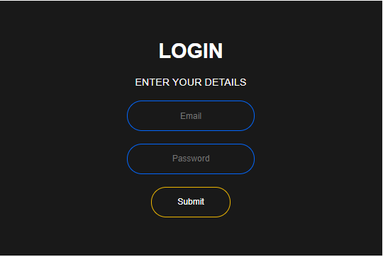
LOGIN PAGE

Slide 6
Login page contains
2 text fields
+ Email (registered email)
+ Password (users account password)
1 button
+ Submit

Slide 7

HOME PAGE

Slide 8
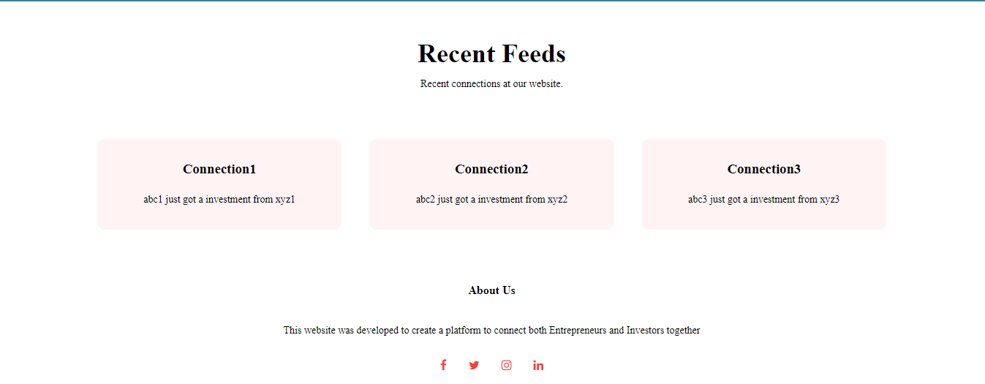

Slide 9
Home page contains
4 tags
+Home
+Investor
+Entrepreneur
+About
2 buttons
+Visit investors
+Visit entrepreneurs

Slide 10
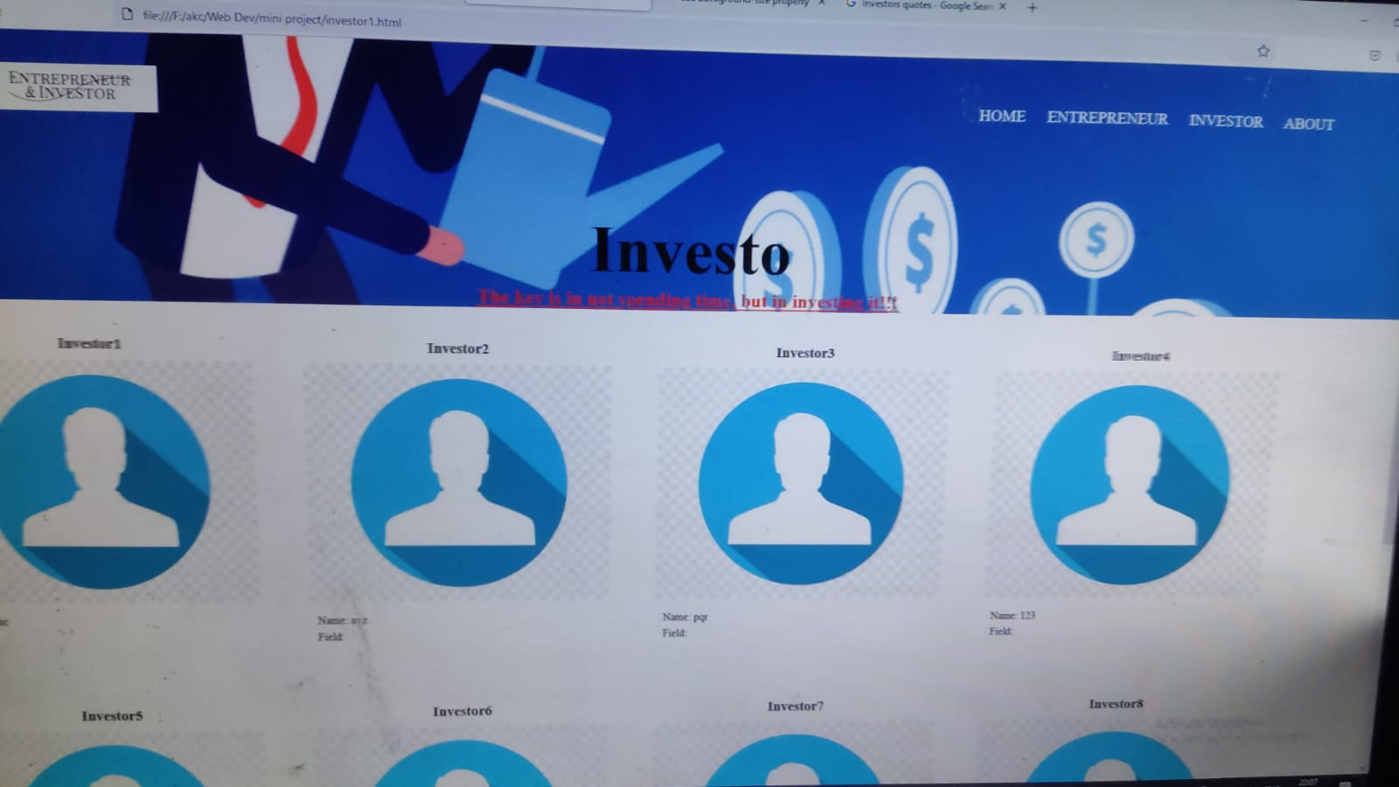
INVESTOR PAGE

Slide 11
Investor page contains
4 tags
+Home
+Investor
+Entrepreneur
+About
Investors details

Slide 12
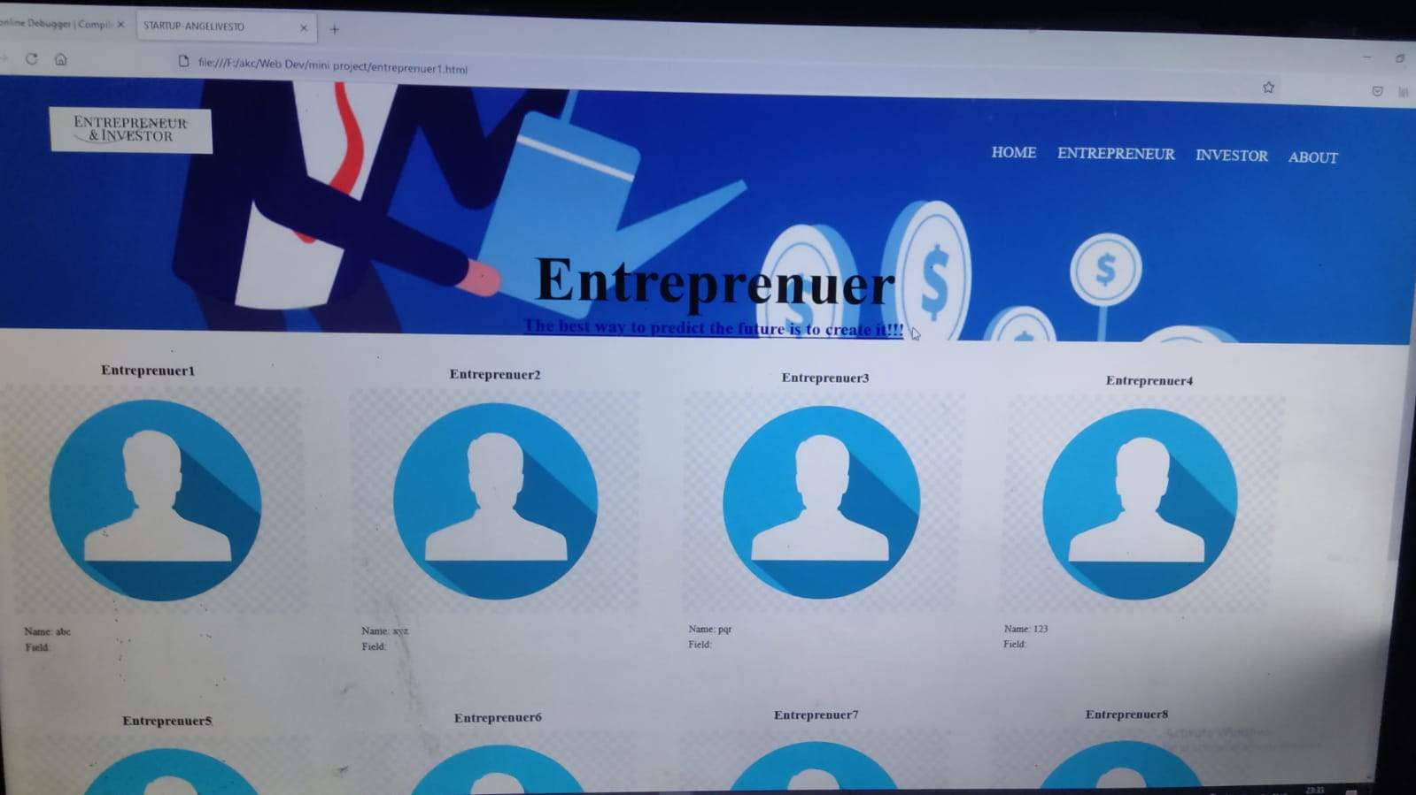
Entrepreneur PAGE

Slide 13
Entrepreneurs page contains
4 tags
+Home
+Investor
+Entrepreneur
+About
Entrepreneur details

Slide 14
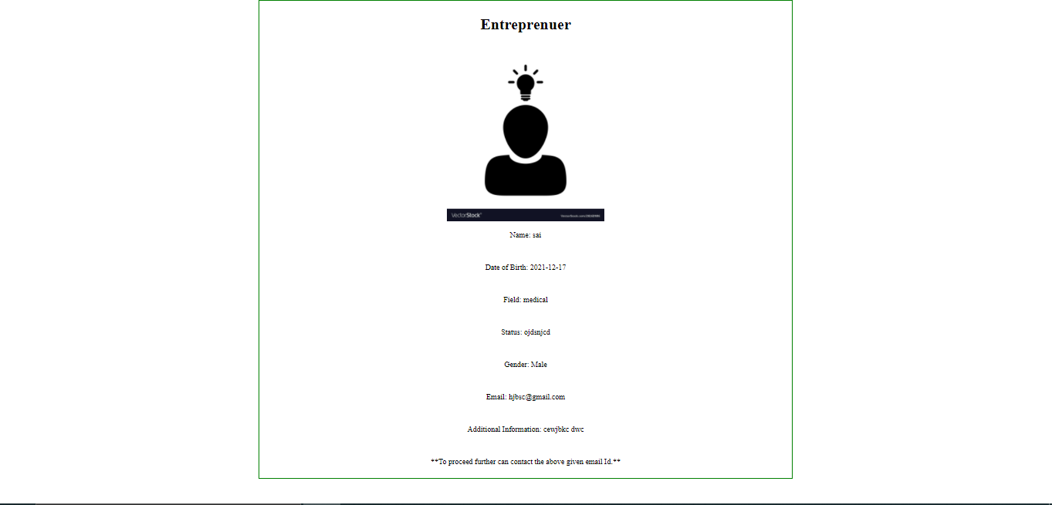
About – Entreprenuer(display)

Slide 15
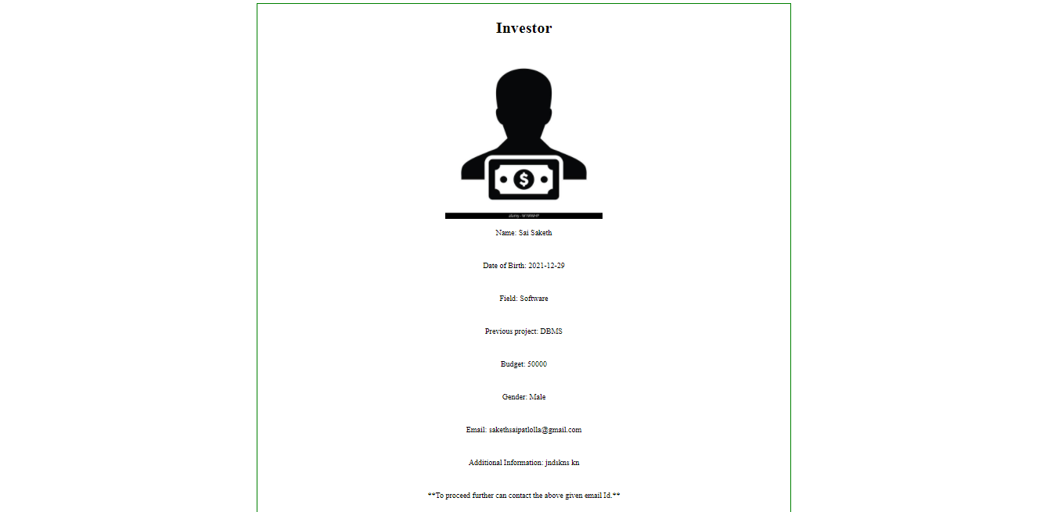
About – Investor(display)

Slide 16
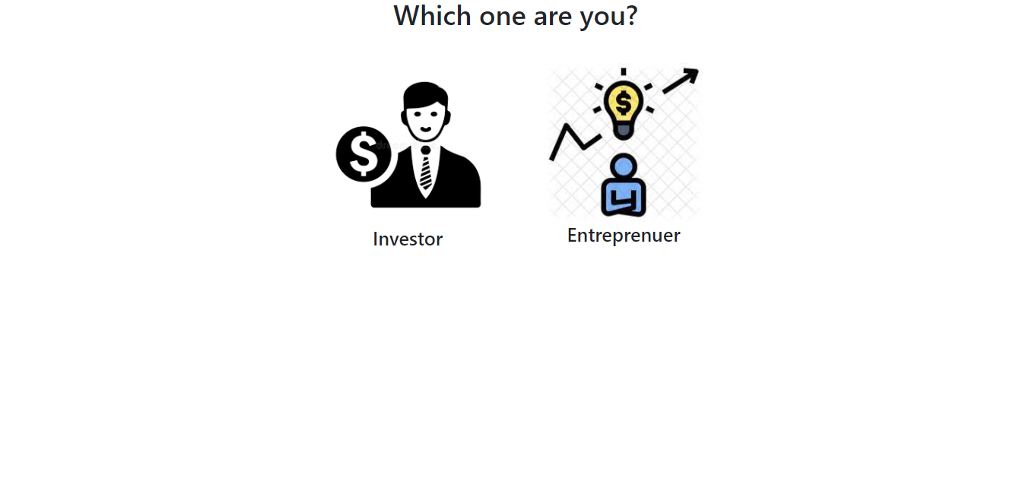
Select

Slide 17

About page - Investor

Slide 18

About page - Entreprenuer

